Slide 1
Informal economy: A new statistical framework on the informal economy
Michael Frosch
frosch@ilo.org
Department of Statistics
ILO

Slide 2
Content
  Why was the previous standards revised
  Outline of the framework in the resolution concerning statistics on the informal economy
  -Underlying concept
  -Overarching concepts
  -Structure of the framework

Slide 3
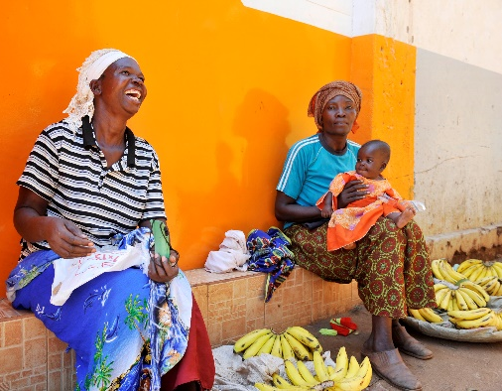

Statistical standards on informality
2023
October
21st ICLS resolution
concerning statistics on the informal economy
A comprehensive framework
Replaces the previous standards (15th ICLS resolution, 17th ICLS guidelines)
Combines the two perspectives i.e., economic units and jobs/persons.
2003
17th ICLS Guidelines concerning a statistical definition of informal employment
Informal employment (job-based concept)
Expanded the boundaries of informality
1993
15th ICLS Resolution concerning statistics of employment in the informal sector
Informal sector (enterprise-based concept)
Employment in the informal sector (job-based concept, but relies on the type of enterprise

Slide 4

Why was a revision necessary?
A need to align to country practices
    Previous definitions of informal sector and informal employment are flexible.
    Estimates can be produced for more than 100 countries.
    “Consensus” around main criteria to use.
    Further strengthen statics on informal economy
    Better explain the statistical meaning of “informal”.
    Clarify the links and differences between the different concepts and definitions.
    Provide stronger recommendations for countries operationalization and data collection.
    Better answer to the national policy needs for data.
Align to the changes in labour statistical standards.
    2013: 19th ICLS resolution concerning statistics on work, employment and labour underutilization
              The concept of work and the different forms of work
    2018: 20th ICLS resolution concerning statistics on work relationships
              ICSE-18, dependent contractors etc.

Slide 5
21st ICLS resolution I
The three standards
    Are aligned and built upon each other.
    The most effective implementation of 21st ICLS resolution requires an implementation of the 19th and 20th ICLS resolutions.
    However, the standards in the 21st ICLS resolution can still be used even if ICSE-18 is not yet implemented:
              main deviation would be the lack of the identification of dependent contractors.
    More problematic if the 19th ICLS resolution has not yet been implemented.
    Can be viewed as a good opportunity to implement ICSE-18 and the 19th ICLS resolution (if not yet done).
21st ICLS resolution
20th ICLS resolution
19th ICLS resolution

Slide 6
What is informality?

Slide 7
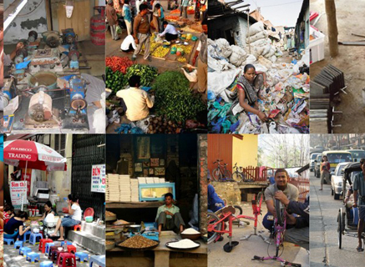
Informality has multiple faces
Includes different types of activities
  From street vendors, shoe-shining and other minor activities requiring little or no capital and skills
  To manufacturing, tailoring, car repair demanding more skills and capital and with higher productivity.
  It includes employees, self-employed, CFW etc.
  Informality exists everywhere, low-income countries, emerging countries, and high-income countries

Slide 8
Informality has multiple faces
Why workers have informal jobs
  Survival strategies, due to lack of (adequate) jobs
  A wish for independency and flexible work arrangements
  More profitable than working in the formal sector
  Too expensive to be formal
  The continuation of traditional activities
  Avoiding regulations
  and so on……….

Slide 9
What is informality according to the 21st ICLS resolution?
    Broadly, it can be understood as activities, persons, economic units that are not –in law or in practice -being effectively covered by formal arrangements.
    Not effectively covered by regulations and procedures to protect and regulate the action and function of economic units, persons and their activities:
Procedures established by the government
  Regulations that stipulate the responsibilities and obligations of the economic units and the workers;
  Commercial law: regulates the activities carried out by economic units, to engage in commercial contracts, to safeguard their intellectual and physical property, etc.
  Labour laws (annual paid leave; minimum wage, hours of work, etc..) and social security laws
  Procedures that regulates access to the institutional infrastructure such as, markets, governmental support mechanisms and financial institutions including banks
Procedures to report economic activities, employees
Fiscal obligations : in order to pay taxes (on production, on sales)
Register employees for social security, etc.

Slide 10
Not being covered –in law or in practice-
Captures two different situations
  In law: Activities can be informal due to a lack of legal coverage.
  For example: when specific type of activities, workers or economic units are exempted from regulations and therefore lack access to formal arrangements.
  Both situations generates informality
  A job, an economic unit and the productive activities carried out, is considered informal independent on whether there is a lack of legal coverage or an –in practice- coverage
  In practice: Activities can be informal due to that while there is a coverage “by law” there is no effective access to the formal arrangements.
  A lack of compliance, for example when the employer do not effectively give access to social insurance or employment benefits, or an enterprise is not registered even though there is an obligation to register.

Slide 11
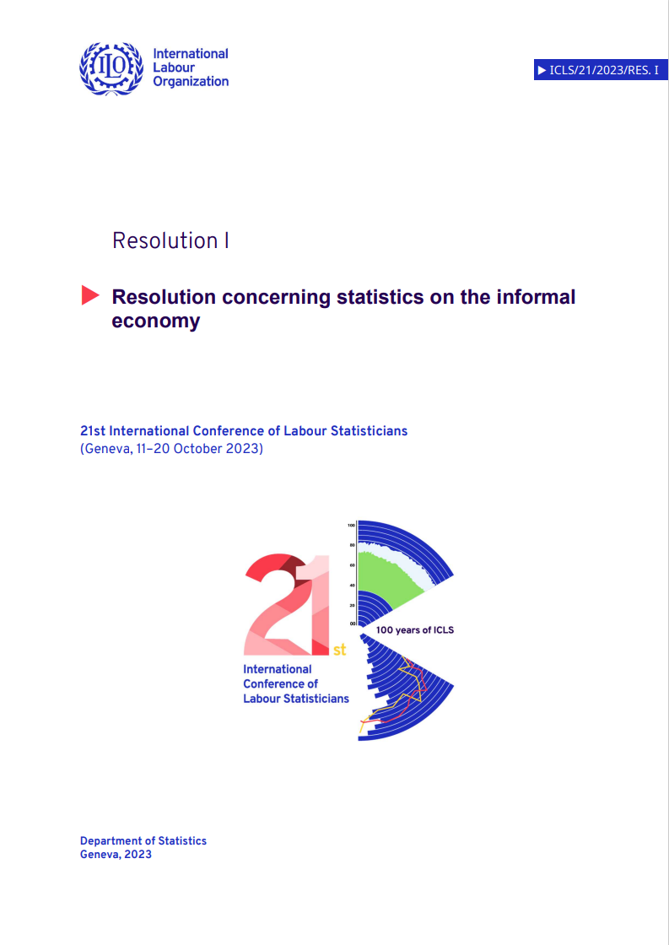
Outline of the framework in the resolution concerning statistics on the informal economy
-Overarching concepts; Informal Economy, informal market economy, informal work
-Structure of the framework

Slide 12

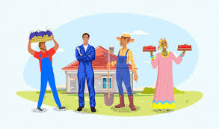
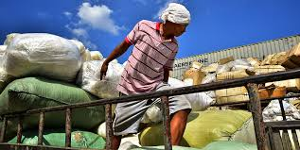
Informal Economy
Overarching concept
    Defined as: “comprises all informal productive activities of persons or economic units, whether or not they are carried out for pay or profit.”
    Informal productive activities “all productive activities carried out by persons or economic units that are – in law or in practice – not covered by formal arrangements”
Economic
units:
Informal enterprises (informal sector)
Households' informal production (HOC
-
sector)
Informal work:
Informal employment
Informal; unpaid trainee work, volunteer work,
own
-
use production work
In the formal sector, informal sector or HOC sector

Slide 13
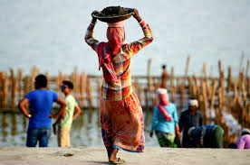
Informal work
Overarching concept
    Defined as: “consists of productive activities performed by persons that are – in law or in practice – not covered by formal arrangements.”
    Recognizes informality in relation to the different forms of work
    Informal activities in relation to employment, volunteer work, unpaid trainee work, own-use production work (both goods and services), other work activities.
Informal market economy
Restricted overarching concept
    Defined as: “all production for pay or profit in the informal sector and all productive activities of workers in employment that are – in law or in practice – not covered by formal arrangements.”
              Focused concept capturing the core elements in the informal economy, informal employment and informal sector.
sector)

Slide 14
Outline of the framework in the resolution concerning statistics on the informal economy
-Overarching concepts; Informal Economy, informal market economy, informal work
-Structure of the framework

Slide 15
The structure of the framework
Informal productive activities by persons in the informal economy
Persons |  | Informal work in the informal economy
Main intention of the productive activities |  | For pay or profit
 |  | Informal productive activities in relation to employment
Informal productive activities by persons |  | Formal employment with partly informal activities * | Informal employment *
Sector of the economic unit for which the work is provided |  | Formal sector | Formal sector
 |  |  | Informal sector *
 |  | Household own-use community sector | Household own-use community sector
Relation to SNA production boundary |  | SNA production boundary
 |  | SNA general production boundary
Not mainly intended to generate pay or profit
Informal productive activities in relation to forms of work other than employment
Informal unpaid trainee work Informal organization-based volunteer work Informal other work activities | Informal own-use production work Direct volunteer work
Formal sector
Informal sector *
Household own-use community sector | Household own-use community sector
 | Goods | Services

Slide 16
Informal productive activities for pay or profit
Persons |  | Informal work in the informal economy
Main intention of the productive activities |  | For pay or profit
 |  | Informal productive activities in relation to employment
Informal productive activities by persons |  | Formal employment with partly informal activities * | Informal employment *
Sector of the economic unit for which the work is provided |  | Formal sector | Formal sector
 |  |  | Informal sector *
 |  | Household own-use community sector | Household own-use community sector
Relation to SNA production boundary |  | SNA production boundary
 |  | SNA general production boundary

Slide 17
The structure of the framework
Informal productive activities by persons in the informal economy
Persons |  | Informal work in the informal economy
Main intention of the productive activities |  | For pay or profit
 |  | Informal productive activities in relation to employment
Informal productive activities by persons |  | Formal employment with partly informal activities * | Informal employment *
Sector of the economic unit for which the work is provided |  | Formal sector | Formal sector
 |  |  | Informal sector *
 |  | Household own-use community sector | Household own-use community sector
Relation to SNA production boundary |  | SNA production boundary
 |  | SNA general production boundary
Not mainly intended to generate pay or profit
Informal productive activities in relation to forms of work other than employment
Informal unpaid trainee work Informal organization-based volunteer work Informal other work activities | Informal own-use production work Direct volunteer work
Formal sector
Informal sector *
Household own-use community sector | Household own-use community sector
 | Goods | Services

Slide 18
The structure of the framework
Informal productive activities and forms of work other than employment
Informal work in the informal economy
Not mainly intended to generate pay or profit
Informal productive activities in relation to forms of work other than employment
Informal unpaid trainee work Informal organization-based volunteer work Informal other work activities | Informal own-use production work Direct volunteer work
Formal sector
Informal sector *
Household own-use community sector | Household own-use community sector
 | Goods | Services

Slide 19
The structure of the framework
Informal productive activities by economic units in the informal economy
Economic units
Sector
Informal productive activities by economic units
Form of informal work as input to production | For pay or profit
 | Not for pay or profit
Relation to SNA production boundary
Informal production
Formal sector
Production in the formal sector is formal
Informal employment *
Partly informal productive activities of persons in formal employment *
Informal unpaid trainee work
Informal volunteer work
Goods and services
SNA production boundary
SNA general production boundary
Informal sector *
All production by informal household unincorporated market enterprises
Informal employment *
Informal unpaid trainee work
Informal volunteer work
Household own-use production and community sector
Production by informal employees engaged by households and non-formal non-profit organizations | Informal household own-use production, direct volunteer work, production by non-formal non-profit organizations
Informal employment *
Partly informal productive activities of persons in formal employment *
Informal unpaid trainee work | Informal volunteer work
 | Informal own-use production work
 | Goods | Services

Slide 20
The structure of the framework
Informal production in the informal sector
Economic units
Sector
Informal productive activities by economic units
Form of informal work as input to production | For pay or profit
 | Not for pay or profit
Relation to SNA production boundary
Informal production
Informal sector *
All production by informal household unincorporated market enterprises
Informal employment *
Informal unpaid trainee work
Informal volunteer work

Slide 21
The structure of the framework
Informal productive activities by economic units in the informal economy
Economic units
Sector
Informal productive activities by economic units
Form of informal work as input to production | For pay or profit
 | Not for pay or profit
Relation to SNA production boundary
Informal production
Formal sector
Production in the formal sector is formal
Informal employment *
Partly informal productive activities of persons in formal employment *
Informal unpaid trainee work
Informal volunteer work
Goods and services
SNA production boundary
SNA general production boundary
Informal sector *
All production by informal household unincorporated market enterprises
Informal employment *
Informal unpaid trainee work
Informal volunteer work
Household own-use production and community sector
Production by informal employees engaged by households and non-formal non-profit organizations | Informal household own-use production, direct volunteer work, production by non-formal non-profit organizations
Informal employment *
Partly informal productive activities of persons in formal employment *
Informal unpaid trainee work | Informal volunteer work
 | Informal own-use production work

Slide 22
The structure of the framework
Informal productive activities by economic units in the informal economy
Economic units
Sector
Informal productive activities by economic units
Form of informal work as input to production | For pay or profit
 | Not for pay or profit
Informal production
Household own-use production and community sector
Production by informal employees engaged by households and non-formal non-profit organizations | Informal household own-use production, direct volunteer work, production by non-formal non-profit organizations
Informal employment *
Partly informal productive activities of persons in formal employment *
Informal unpaid trainee work | Informal volunteer work, informal own-use production work

Slide 23
The structure of the framework
Informal productive activities by economic units in the informal economy
Economic units
Sector
Informal productive activities by economic units
Form of informal work as input to production | For pay or profit
 | Not for pay or profit
Relation to SNA production boundary
Informal production
Formal sector
Production in the formal sector is formal
Informal employment *
Partly informal productive activities of persons in formal employment *
Informal unpaid trainee work
Informal volunteer work
Goods and services
SNA production boundary
SNA general production boundary
Informal sector *
All production by informal household unincorporated market enterprises
Informal employment *
Informal unpaid trainee work
Informal volunteer work
Household own-use production and community sector
Production by informal employees engaged by households and non-formal non-profit organizations | Informal household own-use production, ,direct volunteer work, production by non-formal non-profit organizations
Informal employment *
Partly informal productive activities of persons in formal employment *
Informal unpaid trainee work | Informal volunteer work
 | Informal own-use production work

Slide 24
The structure of the framework
Informal productive activities by economic units in the informal economy
Economic units
Sector
Informal productive activities by economic units
Form of informal work as input to production | For pay or profit
 | Not for pay or profit
Relation to SNA production boundary
Informal production
Formal sector
Production in the formal sector is formal
Informal employment *
Partly informal productive activities of persons in formal employment *
Informal unpaid trainee work
Informal volunteer work
Goods and services
SNA production boundary
SNA general production boundary

Slide 25
The structure of the framework
Informal productive activities by economic units in the informal economy
Economic units
Sector
Informal productive activities by economic units
Form of informal work as input to production | For pay or profit
 | Not for pay or profit
Relation to SNA production boundary
Informal production
Formal sector
Production in the formal sector is formal
Informal employment *
Partly informal productive activities of persons in formal employment *
Informal unpaid trainee work
Informal volunteer work
Goods and services
SNA production boundary
SNA general production boundary
Informal sector *
All production by informal household unincorporated market enterprises
Informal employment *
Informal unpaid trainee work
Informal volunteer work
Household own-use production and community sector
Production by informal employees engaged by households and non-formal non-profit organizations | Informal household own-use production, direct volunteer work, production by non-formal non-profit organizations
Informal employment *
Partly informal productive activities of persons in formal employment *
Informal unpaid trainee work | Informal volunteer work
 | Informal own-use production work

Slide 26
In addition:
    Improved definitions and recommendations for operationalization
    Strengthened definitions of informal employment and informal sector.
    Stronger recommendations for how countries should operationalize the definitions.
    Lead to improved measurement and increased harmonization among countries.
    Supporting indicator framework
    Provide data on the structure of informality within a country
    Allows the identification of workers and economic units highly represented or exposed to informality.
    Provide a more granular context to the dichotomy of informality/formality.
    A selected set of indicators is included in the draft resolution.
    Additional indicators included in the supporting indicator framework.

Slide 27
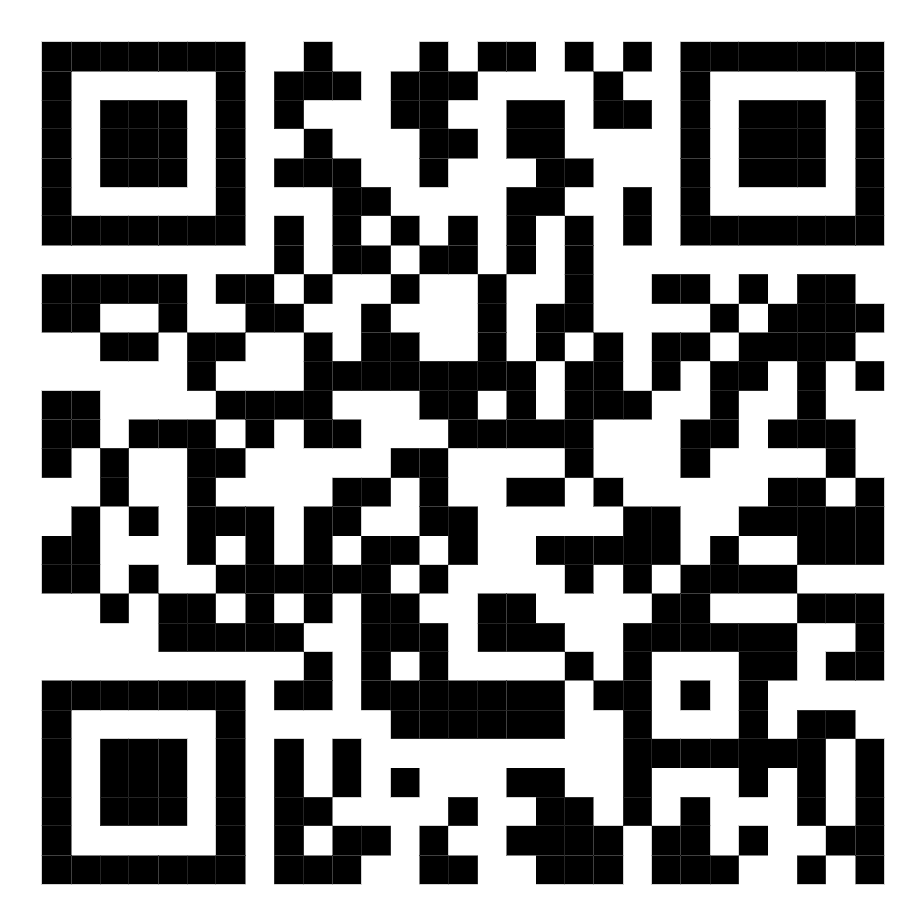
Informal Economy: Resource page
https://ilostat.ilo.org/topics/informality/
Thank you
https://www.ilo.org/resource/resolution-concerning-statistics-informal-economy

